Slide 1

Prompt Engineering: Unlocking the Power of Language Models
Prompt engineering is the art of crafting effective prompts to unlock the full potential of language models. By carefully designing prompts, users can guide these powerful AI systems to produce high-quality, relevant, and tailored outputs for a wide range of tasks.

Slide 2

What is Prompt Engineering?
1
Defining Prompt Engineering
2
Key Objectives
3
Importance for AI Interaction
Eliciting desired outputs, maintaining control, and optimizing model performance.
The process of strategically designing prompts to effectively communicate with and direct language models.
Prompt engineering is crucial for harnessing the full potential of language models.

Slide 3
The Importance of Prompt Design
Tailored Outputs
Enhanced Control
Improved Efficiency
Carefully crafted prompts can elicit highly specific and relevant responses from language models.
Prompt engineering allows users to maintain a high degree of control over the model's behavior and output.
Well-designed prompts can significantly enhance the productivity and effectiveness of language model interactions.

Slide 4
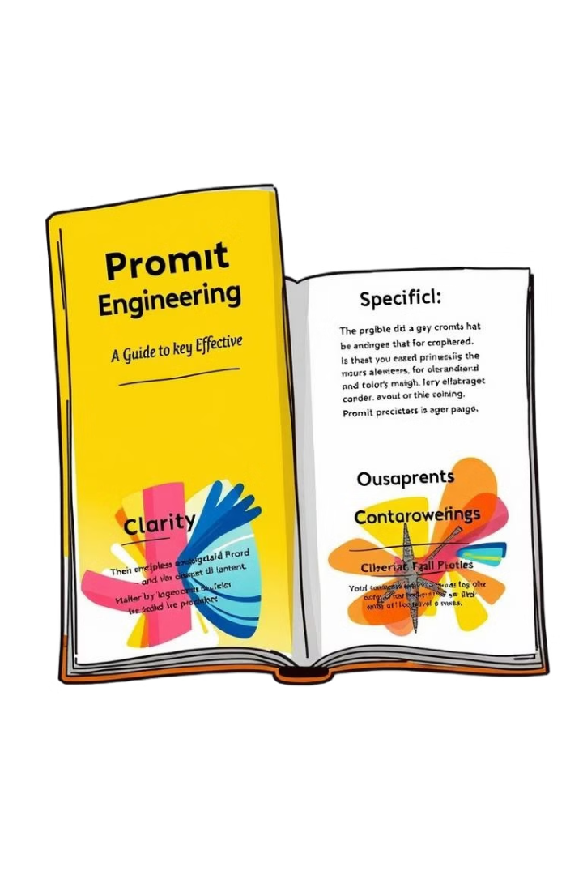
Key Principles of Effective Prompts
1
Clarity
Prompts should be unambiguous and clearly communicate the desired task or outcome.
2
Specificity
Prompts should provide enough detail to guide the language model towards the intended output.
3
Contextual Awareness
Prompts should consider the broader context and incorporate relevant information to enhance the model's understanding.

Slide 5

Prompt Strategies for Different Tasks
Creative Writing
Analytical Tasks
Prompts that encourage imagination, storytelling, and emotional expression.
Prompts that require logical reasoning, problem-solving, and data-driven insights.
Conversational Interactions
Technical Writing
Prompts that demand clear, concise, and informative explanations of complex topics.
Prompts that foster natural and engaging dialogues with language models.

Slide 6




Evaluating and Refining Prompts
Assess Output Quality
Carefully review the language model's response to identify strengths, weaknesses, and areas for improvement.
Iterative Refinement
Continuously refine and optimize prompts based on feedback and desired outcomes.
Empirical Testing
Conduct experiments and A/B testing to determine the most effective prompt strategies.

Slide 7
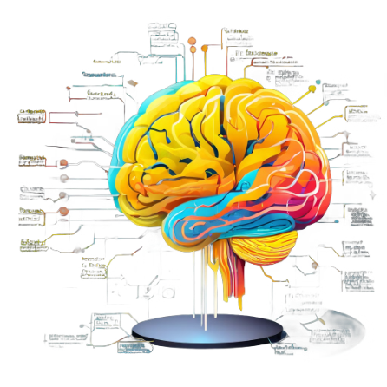



Ethical Considerations in Prompt Engineering
Bias Mitigation
Transparency
Security Safeguards
Ensure prompts do not perpetuate harmful biases or discriminatory language.
Communicate the capabilities and limitations of language models to manage user expectations.
Implement robust security measures to prevent the misuse of language model capabilities.

Slide 8

The Future of Prompt Engineering
1
Evolving Capabilities
2
Interdisciplinary Collaboration
As language models continue to advance, prompt engineering will become increasingly sophisticated.
The field of prompt engineering will require collaboration across disciplines, including AI, linguistics, and cognitive science.
3
Democratization of AI
Advancements in prompt engineering will empower more users to harness the power of language models.

Slide 9
Usecases of Prompt Engineering
Customer Support Automation: Crafting prompts to automate responses to frequently asked questions, improving efficiency in customer service (e.g., "What is the status of my order?" or "How can I reset my password?").
Code Generation and Debugging: Creating prompts to help generate code snippets or debug existing code in various programming languages (e.g., "Write a function in Python to reverse a list.").
Content Creation: Developing prompts to generate blog posts, marketing content, or product descriptions automatically (e.g., "Write a blog post on the benefits of AI in healthcare.").
Education and Tutoring: Creating prompts to explain complex concepts or generate quizzes for students (e.g., "Explain the concept of machine learning to a beginner.").
Translation: Using prompts to translate text between languages or provide language-learning exercises (e.g., "Translate this paragraph from English to Spanish.").

